Slide 1
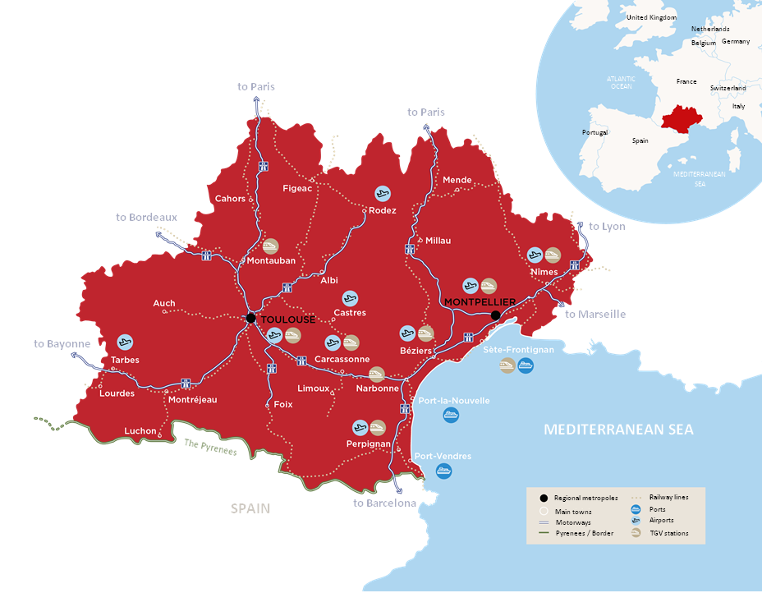
OCCITANIE in the south of France
One of Europe’s most
attractive regions
6 million
inhabitants
+50,000
new
inhabitants per year
Toulouse
Montpellier
Frankfurt 1h45
Algiers 1h15
London 1h55
Marseille 1h35
Amsterdam 1h55
Lyon 1h40
Bordeaux 2h10
Paris 3h15
Paris 4h15
Barcelona 3h20

Slide 2
OCCITANIE
Leading transition towards a
a more responsible world
VISIONARY
a spirit of innovation, the future is already here
MONTPELLIER
INGENIOUS
bubbling with talent
and know-how
TOULOUSE
COMMITTED
respect for the resources
of the planet
WELCOMING
AND SUPPORTIVE
we forget no-one

Slide 3
Sectors of excellence
IN OCCITANIE
AERONAUTICS
World leader in civil aeronautics, green aircraft will soon be taking off from here
DIGITAL
Serving progress
AGRICULTURE & AGRI-FOOD
With a focus on quality and innovation
SPACE
The hub of European space activities.
Occitanie has always been
one step ahead
INDUSTRIES
CULTURAL AND CREATIVE
New imaginary worlds come to life
TOURISM
Committed to sustainable tourism
SEA
The blue economy has the wind in its sails
RENEWABLE ENERGIES
On the way to becoming the 1st positive
energy region in Europe
INTELLIGENT AND SUSTAINABLE
MOBILITIES
Innovating and decarbonising transport
HEALTHCARE
Reconnecting with sovereignty
HIGHER EDUCATION AND RESEARCH
Training new talent and preparing for the future

Slide 4
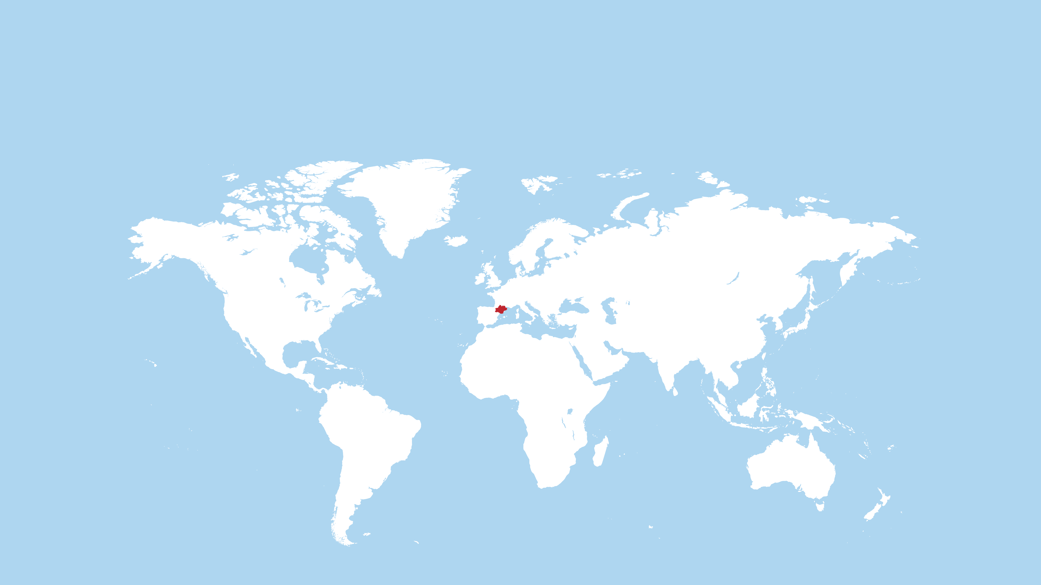
Open to the world with 7 representative offices worldwide: Maisons de l'Occitanie
LONDON
BRUSSELS
HAMBURG
SHANGHAI
NEW-YORK
CASABLANCA
TOKYO

Slide 5
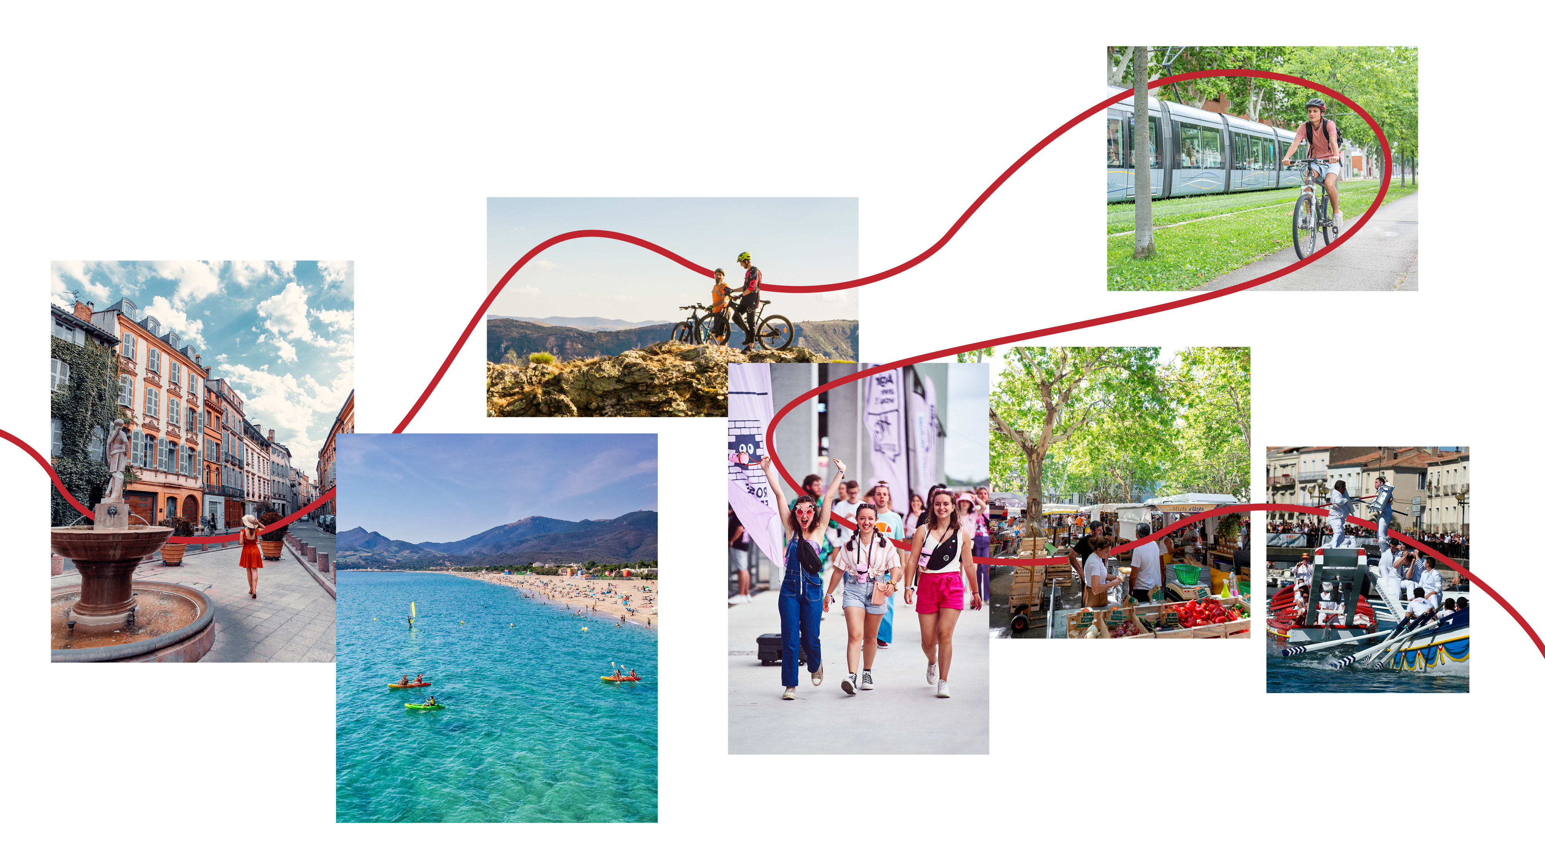
OCCITANIE
Combining quality infrastructures and lifestyle
EXCITING
AUTHENTIC
A COLLECTIVE SPIRIT
TAKING CARE OF EACH OTHER
WELCOMING

